Slide 1
MAS Data Science and Engineering Machine Learning
Natasha Balac, Ph.D.
Predictive Analytics Center of Excellence, Director
San Diego Supercomputer Center
University of California, San Diego

Slide 2
WELCOME
Logistics
Check-in from 8:15am – 9:00am
Parking
Restrooms
Lunch
Agenda
Technical Sessions
Hands-on Sessions
Interactive format
Assignments & Final
TA Hours; Communication; Piazza

Slide 3
Team
Anwaya Aras - aaras@eng.ucsd.edu
Natasha Balac – nbalac@ucsd.edu

Slide 4

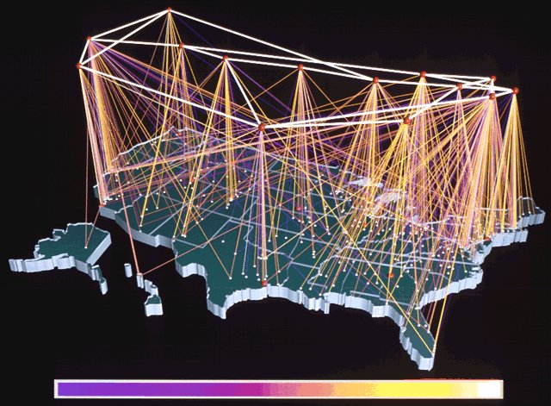

Brief History of SDSC
1985-1997: NSF national supercomputer center; managed by General Atomics
1997-2007: NSF PACI program leadership center; managed by UCSD
PACI: Partnerships for Advanced Computational Infrastructure
2007-2009: Internal transition to support more diversified research computing
still NSF national “resource provider”
2009-future: Multi-constituency cyberinfrastructure (CI) center
provide data-intensive CI resources, services, and expertise for campus, state, and nation
Approaching $1B in lifetime contract and grant activity

Slide 5
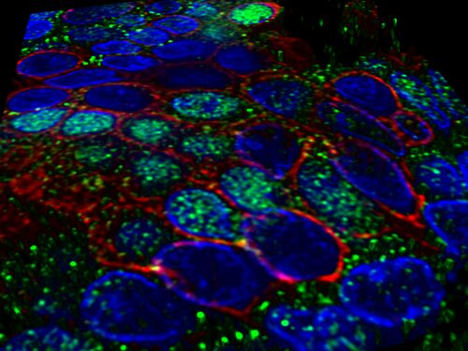
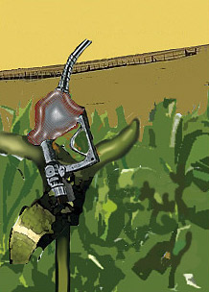


Today’s Information Technologies Drive 21st Century Solutions
Labs and Centers
Advanced Query Processing
Spatial Data Systems
Data-Driven High Performance Computing
Scientific Workflow Automation Technologies
Large-scale Data Systems
Predictive Analytics
Data Visualization
We teach and mentor students
Graph Data Management
Semantic Web
Machine Learning and Analytics
GIS and Spatial Technologies
Information Integration
Text Analytics
Big Data technologies
What therapies can be used to cure or control cancer?
What plants work best for biofuels?
Will California levees hold in a large-scale earthquake?
Can financial data be used to accurately predict market outcomes?

Slide 6

What is Gordon?
A “data-intensive” supercomputer based on SSD flash memory and virtual shared memory
Emphasizes MEM and IO over FLOPS
A custom-designed system based on COTS to accelerate access to massive data bases being generated in all fields of science, engineering, medicine, and social science
Designed specifically for data-intensive HPC applications
Notes:
Such applications involve “very large data-sets or very large input-output requirements”
Two data-intensive application classes are important and growing
Data mining and Data intensive predictive science

Slide 7
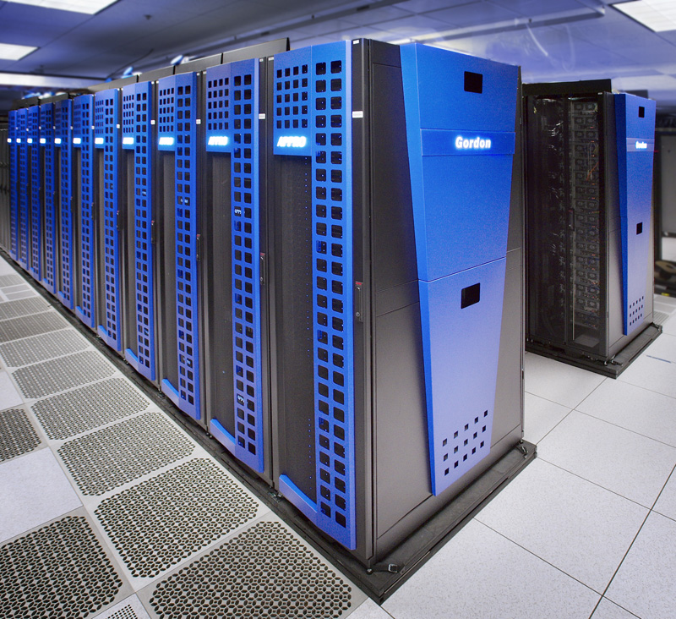
Gordon Speeds and Feeds
Intel Sandy Bridge Compute node
Sockets & Cores | 2 & 16
Clock speed | 2.6 GHz
DRAM capacity and speed | 64 GB, 1,333 MHz
Intel710 eMLC Flash I/O Node
NAND flash SSD drives | 16
SSD capacity per drive & per node | 16 * 300 GB = 4.8 TB
SMP Super-Node (via vSMP)
Compute nodes / I/O Nodes | 32 / 2
Addressable DRAM | 2 TB
Addressable memory including flash | 11.6 TB
Gordon (Aggregate)
Compute Nodes | 1,024
Compute cores | 16,384
Peak performance | 341 TF
DRAM/SSD memory | 64 TB DRAM; 300 TB SSD
InfiniBand Interconnect
Architecture | Dual-Rail, 3D torus
Link Bandwidth | QDR
Vendor | Mellanox
Lustre-based Disk I/O Subsystem (Shared)
Total storage: current/planned | 4 PB/6 PB (raw)
Total bandwidth | 100 GB/s
Notes:
Designed to accelerate access to massive amounts of data in areas of genomics, earth science, engineering, medicine, and others
Emphasizes memory and IO over FLOPS.
Appro integrated 1,024 node Sandy Bridge cluster
300 TB of high performance Intel flash
Large memory supernodes via vSMP Foundation from ScaleMP
3D torus interconnect from Mellanox
In production operation since February 2012
Funded by the NSF and available through the NSF Extreme Science and Engineering Discovery Environment program (XSEDE)

Slide 8
SDSC Repertoire of Storage Systems
Data Oasis (PFS)
Purpose: Typical Project / Home Directory / User File Server Storage Needs
Project Storage
Access: Multi-platform web interface, S3-type interfaces, backup SW
SDSC Cloud
Access: NFS/CIFS, iSCI
Storage of Digital Data for Ubiquitous Access and High-Durability
High-Performance Parallel File System for HPC Systems; Partitioned for Scratch and Medium-Term Parking Space
Access: Lustre on HPC Systems (Gordon, Trestles, Triton)

Slide 9
PACE Predictive Analytics Center of Excellence Closing the gap between Government, Industry and Academia

Slide 10
PACE: Closing the gap between Government, Industry and Academia
Predictive Analysis
Center of Excellence
Inform, Educate and Train
Develop Standards and Methodology
High Performance Scalable
Data Mining
Foster Research and Collaboration
Data Mining Repository of Very Large Data Sets
Provide Predictive Analytics Services
Bridge the Industry and Academia Gap
PACE is a non-profit, public educational organization
To promote, educate and innovate in the area of Predictive Analytics
To leverage predictive analytics to improve the education and well being of the global population and economy
To develop and promote a new, multi-level curriculum to broaden participation in the field of predictive analytics

Slide 11
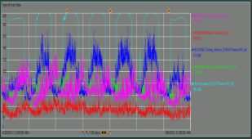
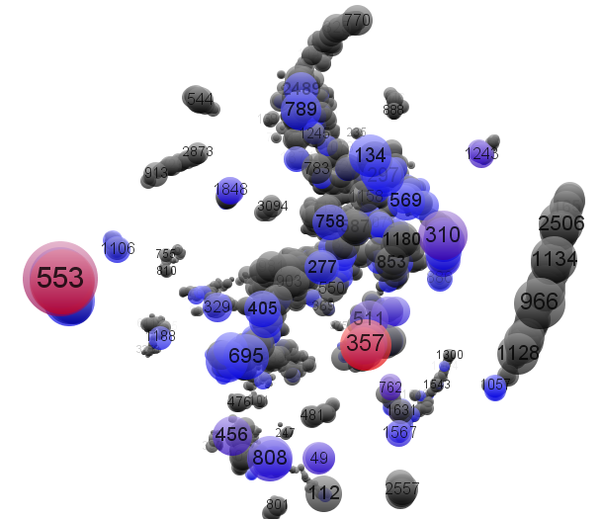
Foster Research and Collaboration
Predictive Analysis
Center of Excellence
Inform, Educate and Train
Develop Standards and Methodology
High Performance Scalable
Data Mining
Foster Research and Collaboration
Data Mining Repository of Very Large Data Sets
Provide Predictive Analytics Services
Bridge the Industry and Academia Gap
Fraud Detection
Modeling user behaviors
Smart Grid Analytics
Distributed Energy Generation
Microgrid anomaly detection
Battery Storage Analytics
Sport Analytics
Genomics

Slide 12
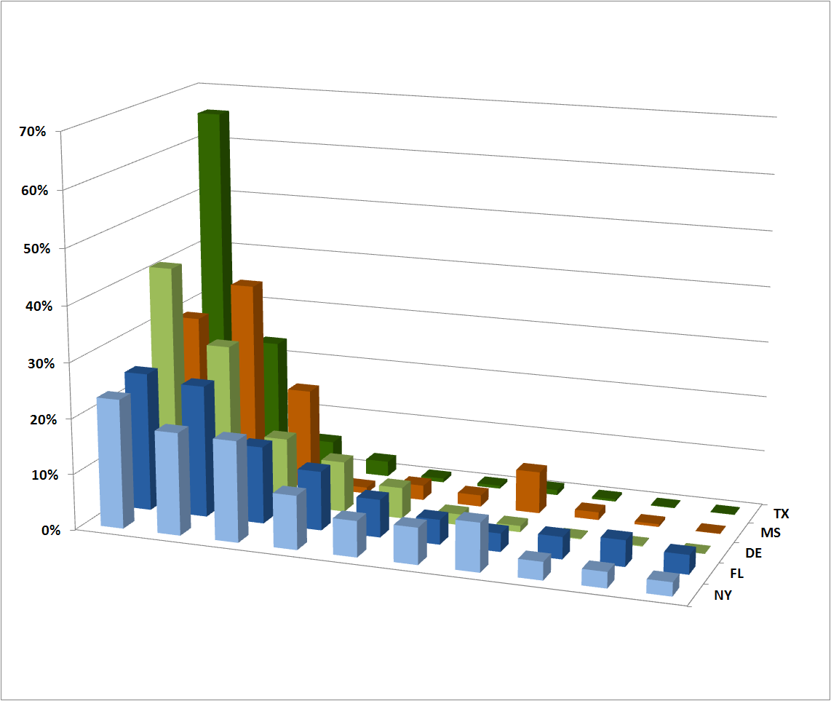
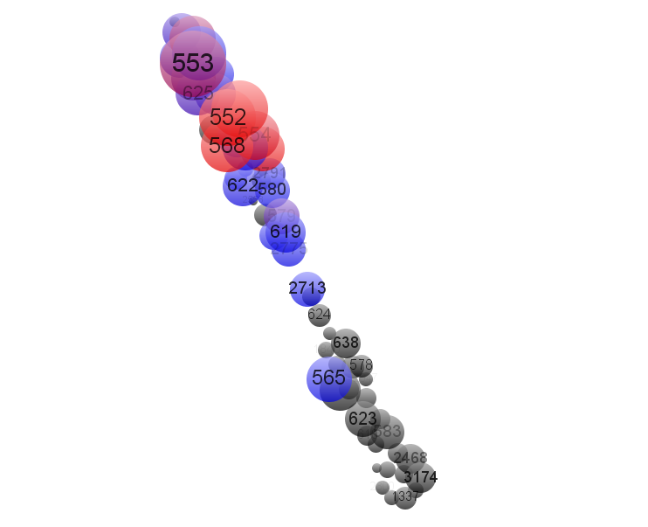
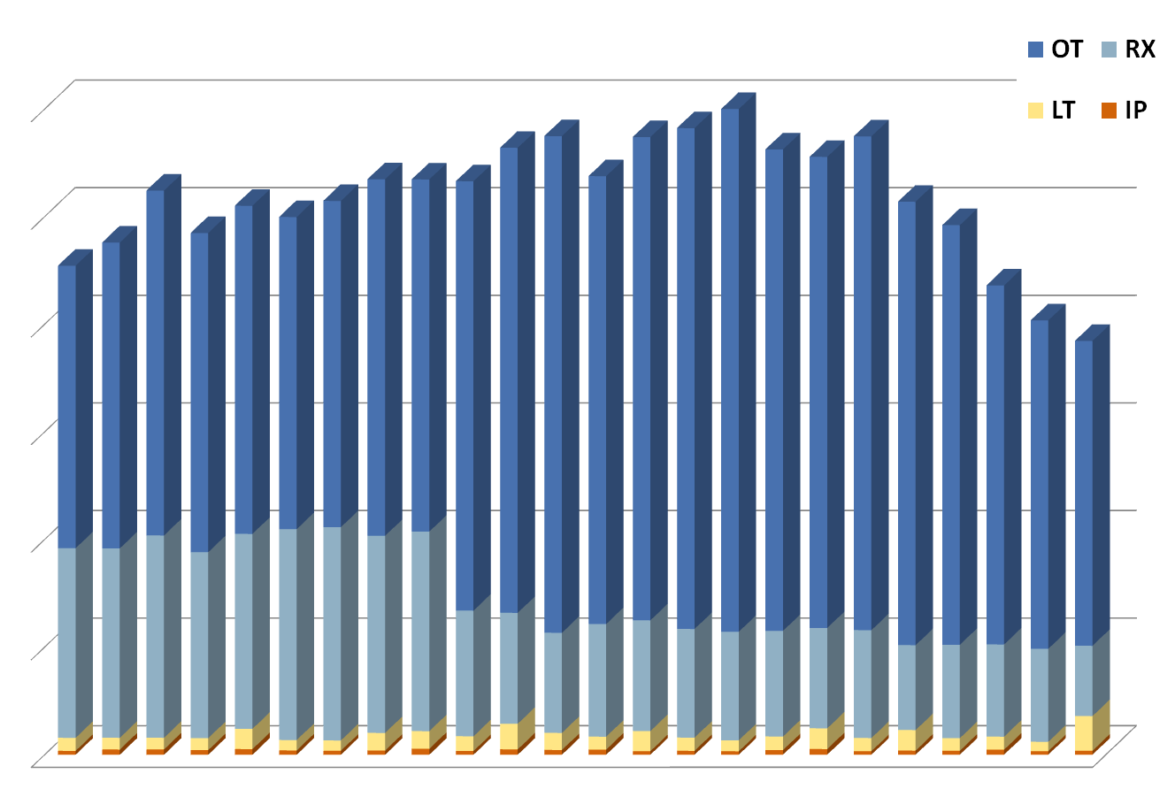
CMS Fraud, Waste and Abuse Detection and Prediction
Descriptive Statistics
Claims summary information
History and trends
Distributions across periods, transactions, etc.
Exploratory Analysis
Profiles of provider transactions
Provider similarity according to profiles
Visual summaries of large amounts of data
Eligibility data link to provider billing
Predictive analytics
Adjustments
Equipment, Service Codes
Long term vs. short term hospital stay
Provider profiles

Slide 13
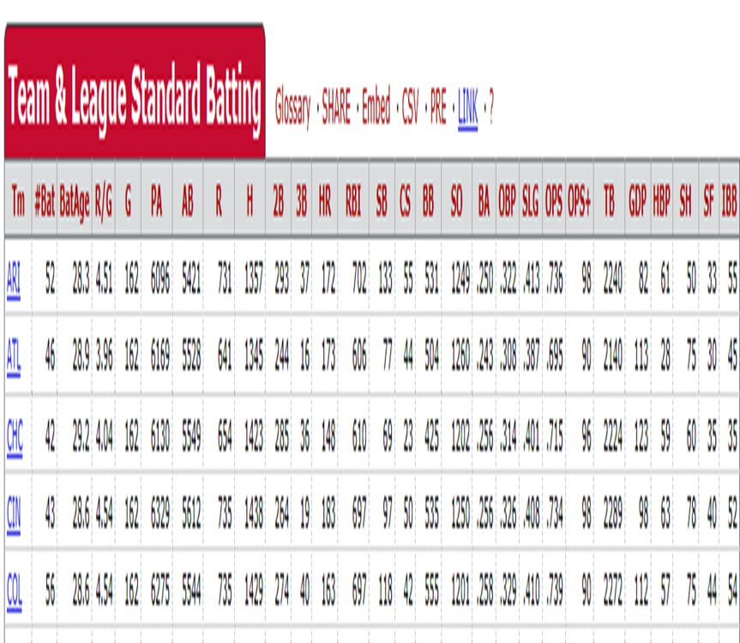
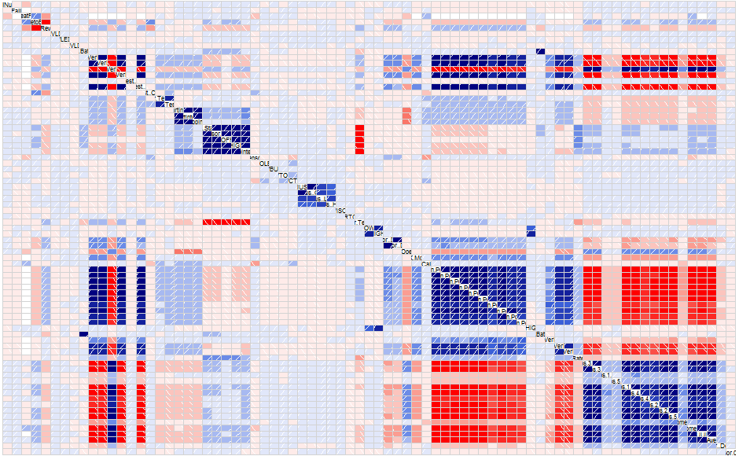
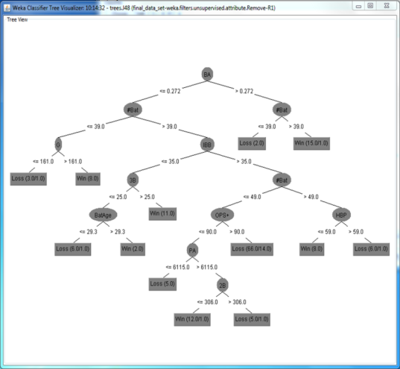
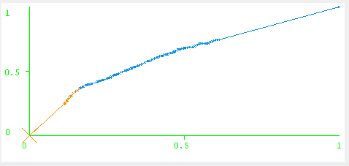
Predictive Analytics In Action
Sports Analytics
Manufacturing

Slide 14

UCSD Smart Grid
UCSD Smart Grid sensor network data set
45MW peak micro grid; daily population of over 54,000 people
Self-generate 92% of its own annual electricity load
Smart Grid data – over 100,000 measurements/sec
Sensor and environmental/weather data
Large amount of multivariate and heterogeneous data streaming from complex sensor networks
Predictive Analytics throughout the Microgrid
Notes:
Extremely large, complex sensor networks, enabling a novel feature reduction method that scales well
The UCSD campus data acquisition system includes over 48,000 datastreams (continuous measurements at one minute intervals since Jan 2011) from the HVAC system, more than 17,000 from the network simulation model, nearly 10,000 additional measurements from electric power meters, and a large number of dependent variables
computed in real time chronological order.
The University of California, San Diego (UCSD) is the owner-operator of a 45 MW peak load Smart Grid and one of the first adopters of many new technologies, including multiple renewable and non-renewable energy generation resources, significant energy storage, and sophisticated monitoring for controlling flex-demand loads for a community of 54,000 energy consumers with an effectually, insatiable demand. With an aim of nurturing consumer adoption of energy-efficient vehicles, UCSD has made considerable progress in a adopting a campus-wide, electric-vehicle (EV) fleet that includes providing direct-to-solar plant connections and storage for solar plant power production. UCSD’s 45 MW microgrid includes a master controller and optimization system that self generates 92% of its own annual electricity load and 95% of its heating and cooling load. It also owns and maintains a 69 kV substation, ninety-six 12kV underground feeder circuits and four 12kV distribution substations throughout the 1200-acre campus.
Managing and controlling actual energy delivery is an optimization and prediction problem that depends on many factors, some of which are present in monitoring within the grid itself, and some of which are only available outside the system, such as weather, residents’ behavior and economics.
Since February 2011, the UCSD campus data acquisition system has collected continuous measurements from the heating, ventilation and air conditioning (HVAC) system at one-minute intervals. More than 17,000 measurements from the network simulation model, nearly 10,000 additional measurements from electric power meters, and a large number of dependent variables computed in real time. The steady state archive writes exceed 500,000 events per second. The simultaneous read rate is over 20,000,000 events per second. This large, complex data holds enormous potential for significant energy savings.
Microgrid Data Preprocessing and asset detection to consumption prediction and anomaly detection at several level of granularity

Slide 15
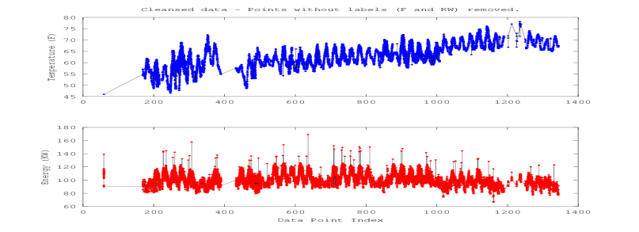
Predictive Analytics for Discovering Energy Consumption Patterns
The utility and the consumer both benefit from consumption analytics
Forecasting the energy consumption patterns in the UCSD campus microgrid
Different spatial and temporal granularities
Novel Feature Engineering
Machine learning for demand response optimization
Notes:
There is a great and immediate need to harness smart grid data to maximize the value of forecasting for transforming the way utilities are managed. The age-old challenge is to supply resources at the lowest resources cost. In the past, most predictive models performed forecasting by using power consumption data only. Our proposed research will leverage not only the traditional meter based power information, but also weather, locale, time of day and other potentially significant factors. Learning consumers’ patterns in relation to the production, demand, environmental indicators and cost of energy is extremely valuable when coupled with data analytics approaches. Applying such approaches to the available data in the energy space will enable informed, real-time decisions and enhancements, resulting in a truly intelligent and optimized micro grid.
Analytics Using Newton’s Law of Cooling
Airflow Data Analysis
Regression tree 2.6% error on predicted vs. actual
We use Machine Learning methods for forecasting the energy consumption patterns in the UCSD campus microgrid, which can be used for energy use planning and conservation.
We use direct indicators of power consumption, such as outside temperature and season, along with novel indirect indicators that are available on a university campus, like academic calendar, class schedules and occupancy data. We use machine-learnt models to predict campus power usage for coarse- (daily) and fine- grained (15-min) time intervals based on the direct and indirect features, utilizing 3 years of sensor data on power usage collected at 15-minute intervals from 170 smart power meters on USC campus.
Regression tree models generate a decision tree with nodes directing to the left or right child based on a feature condition and the leaves of the tree ending in a regression function that predicts the target variable's value (e.g. KWh). Our models perform better than the baselines that are based on the annual mean, time of week mean, and time of year mean. We evaluate the impact of each feature on the model accuracy by training and testing all combinations of the features and comparing their CV-RMSE.
We observe that the day of the week feature is the most important feature for daily campus-level power usage prediction. For the 15-minute campus-level prediction, hourly outside temperature was the best predictor, while weekday was the next. This is understandable, given that temperature values through the day and are more relevant at a finer level of granularity.
The projected increase in the use of AMIs and data collection in a Smart Grid environment means that all applications, including demand forecasting, will be data intensive and require the use of scalable and reliable platforms for operations.
In a Smart Microgrid, both the utility and the consumer can benefit from analytics based on data for electricity consumption and related variables. There are several benefits and costs associated with performing analytics at different spatial and temporal granularities.
analytics for the ucsd campus microgrid to develop reliable electricity consumption forecasting models that would work for different spatial (building-level and campus-level) and temporal granularities (15-min and daily intervals). Our goal is to provide the facility managers more insight into the consumption patterns on the campus and enable them to plan consumption and curtailment activities for Demand Response optimization in the campus microgrid.

Slide 16





Sustainable San Diego Partnership
Clean Tech San Diego, OSIsoft, SDG&E and UC San Diego Common data infrastructure connects physical assets: electrical, gas, water, waste, buildings, transportation &traffic
Platform to securely transfer high volumes of Big Data from multiple, distributed measurement units
Crowd-sourced Big Data in a cyber-secure, private cloud
Predictive analytics on real-time time-series data
White House Big Data Event: “Data to Knowledge to Action” – Launch Partners Award
Predictive Analytics Center of Excellence
Smart Infrastructure
Gas & Electric
Water & Wastewater
Waste Management
Critical Facilities & Buildings
Transportation & Traffic
Communications & Data Centers
Notes:
Sustentable San Diego
Clean Tech San Diego, along with the Predictive Analytics Center of Excellence (PACE), the San Diego Supercomputer Center (SDSC) at the University of California, San Diego (UCSD) and OSIsoft are working to develop a “Sustainable Communities” project in San Diego. The premise of the project is to deploy a data infrastructure that connects the various physical infrastructures of downtown San Diego. These physical infrastructures include electrical, gas, water, waste, buildings, transportation and traffic, along with their individual communications support systems. The OSIsoft PI system will connect to and acquire significant volumes of highly granular time-series data from each of the physical environments. Data-owners will be able to publish their data in a cyber-secure, private cloud. PACE’s Big Data analytics researchers will perform predictive analytics on both the real-time and historical time-series data. Possible data applications include detailed load forecasting, load shaping and demand response, all aimed at driving city-scale energy efficiency.
Presently, San Diego Gas & Electric (SDGE) and UCSD are beta-testing the OSIsoft PI Cloud Connect software to securely transfer high-volumes of time-synchronized / time-series data from multiple phasor measurement units (PMUs) within SDGE's system. At the same time, UCSD researchers are utilizing UCSD’s Microgrid to analyze the PMU data to identify disturbance events on both the main SDGE grid and the UCSD Smart Grid. By sharing their data with UCSD researchers, the industry collaborators and city partners will gain new insight into their “crowd-sourced” data. Moreover, the “Sustainable Communities” project will inspire a pipeline of experienced engineers ready to design and deliver sustainability projects to improve the world in which we live.
Another version:
UCSD, Clean Tech San Diego, OSIsoft and San Diego Gas & Electric to create a “Sustainable San Diego”
Clean Tech San Diego, along with the Predictive Analytics Center of Excellence (PACE), the San Diego Supercomputer Center (SDSC) at the University of California, San Diego (UCSD) and OSIsoft are working to develop a “Sustainable Communities” project in San Diego. The premise of the project is to deploy a data infrastructure that connects the various physical infrastructures of downtown San Diego. These physical infrastructures include electrical, gas, water, waste, buildings, transportation and traffic, along with their individual communications support systems. The OSIsoft PI system will connect to and acquire significant volumes of highly granular time-series data from each of the physical environments. Data collected will be published in a cyber-secure, private cloud that is accessible based on signed and approved access mechanism agreements, thereby protecting privacy and ownership of the data. Presently, San Diego Gas & Electric (SDGE) and UCSD are beta-testing the OSIsoft PI Cloud Connect software suite for securely transferring high-volumes of data within SDGE's system. UCSD researchers are simultaneously utilizing UCSD’s Microgrid to analyze the data on both the main SDGE grid and the UCSD Smart Grid. By sharing their data with UCSD researchers, the industry collaborators and city partners will gain new insight into their “crowd-sourced” data. This project will enable the city of San Diego to drive city-scale energy efficiency, load-shaping, and demand-response applications that will lower electricity consumption and cost, discover and anticipate grid instabilities, educate the public, and improve both quality of life and economic development. Moreover, the “Sustainable Communities” project will inspire a pipeline of experienced engineers ready to design and deliver sustainability projects to improve the world in which we live. An overarching goal of this project and its broad collaboration is to develop a model for the collection and refinement of data that is transportable to other communities and applications. The processes developed as well as the results will be published in order to enable other communities in their path to sustainability.

Slide 17
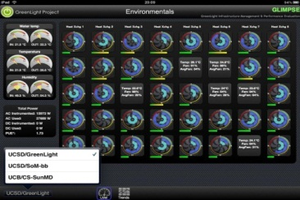
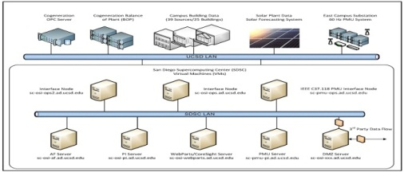
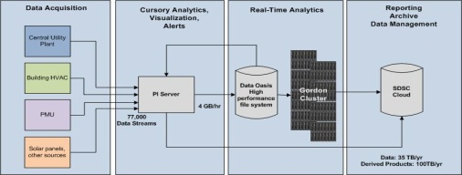
Big Data
Predictive Analysis
Center of Excellence
Inform, Educate and Train
Develop Standards and Methodology
High Performance Scalable
Data Mining
Foster Research and Collaboration
Data Mining Repository of Very Large Data Sets
Provide Predictive Analytics Services
Bridge the Industry and Academia Gap
Complexities introduced by the large amount of multivariate and heterogeneous data streaming from complex sensor networks
Extremely large, complex sensor networks, enabling a novel feature reduction method that scales well
Notes:
Kmeans Results from 10 million NYTimes articles

Slide 18
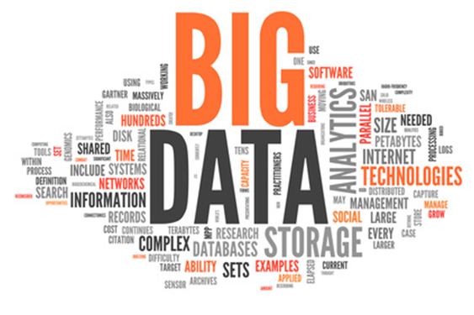

Slide 19
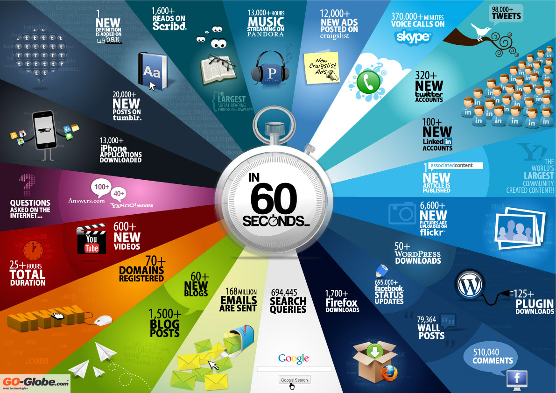

Slide 20
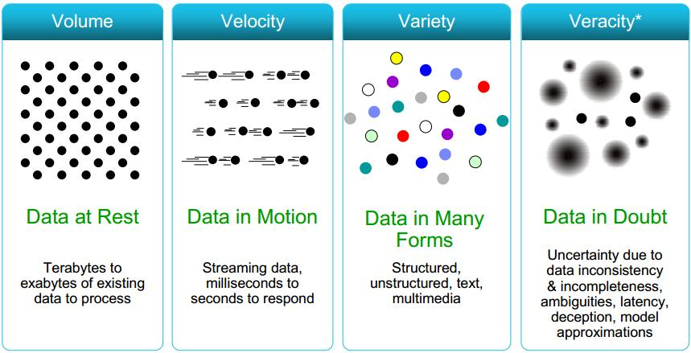
4 V’s of Big Data
IBM, 2012
Notes:
Virality
the tendency of an image, video, or piece of information to be circulated rapidly and widely from one Internet user to another; the

Slide 21
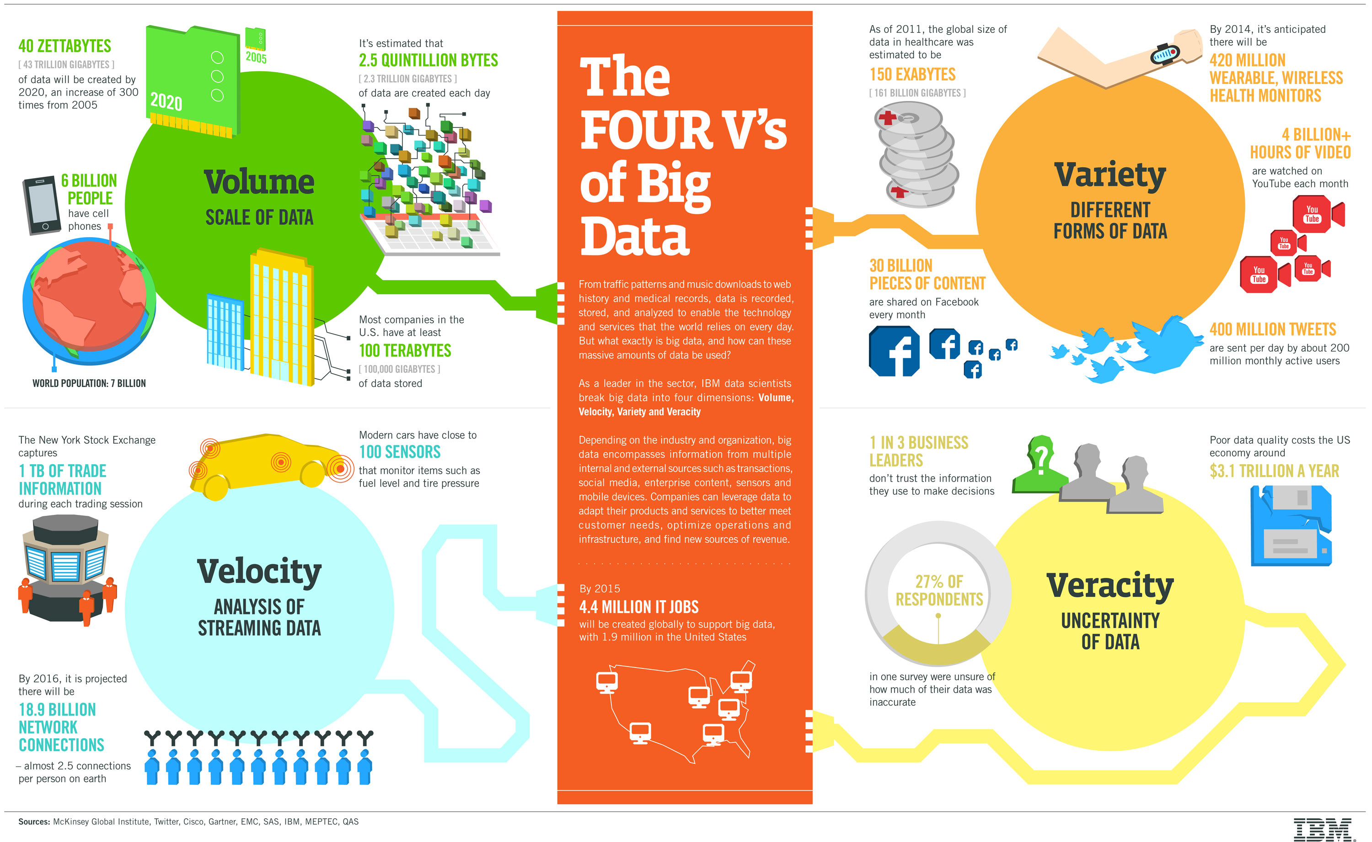

Slide 22
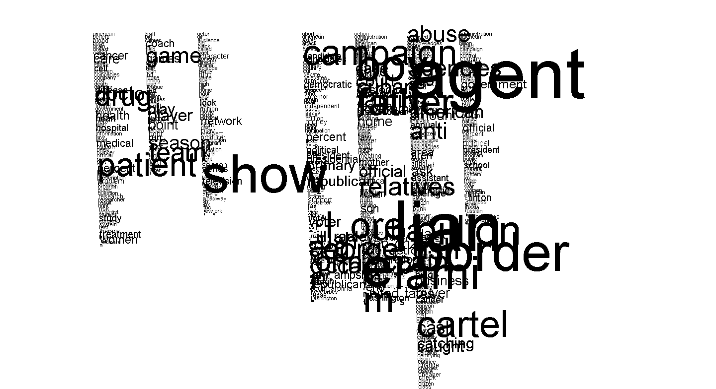
Kmeans Results from 10 million NYTimes articles
cluster means shown
with coordinates
determining fontsize
7 viable clusters found
Notes:
10,000,000 entries from NYTimes articles (http://archive.ics.uci.edu/ml/datasets/Bag+of+Words)

Slide 23
Big Data – Big Training
“Data Scientist”
The “Hot new gig in town”
O’Reilly report
Data Scientist: The Sexiest Job of the 21st Century
Harvard Business Review, October 2012
The next sexy job in next 10 years will be statistician” – Hal Varian, Google Chief Economist
Geek Chic – Wall Street Journal – new cool kids on campus
The future belongs to the companies and people that turn data into products
“The human expertise to capture and analyze big data is both the most expensive and the most constraining factor for most organizations pursuing big data initiatives” – Thomas Davenport
New curriculum – Boot camps, Certificates, Data Science Institute, ‘14 MAS
Notes:
: no one teaches college students how to do ETL, use BI tools (cube) or analyze the data
Companies have realized they need to hire data scientists, academic institutions are scrambling to put together data-science programs, and publications are touting data science as a hot—even “sexy”—career choice. However, there is confusion about what exactly data science is, and this confusion could lead to disillusionment as the concept diffuses into meaningless buzz. – Gartner big data hype cycle
There are good reasons why it has been hard to pin down exactly what is data science. One reason is that data science is intricately intertwined with other important concepts also of growing importance, such as big data and data-driven decision making.
Another reason is the natural tendency to associate what a practitioner does with the definition of the practitioner's field; this can result in overlooking the fundamentals of the field.
We believe that trying to define the boundaries of data science precisely is not of the utmost importance. We can debate the boundaries of the field in an academic setting, but in order for data science to serve business effectively, it is important (i) to understand its relationships to other important related concepts, and (ii) to begin to identify the fundamental principles underlying data science. Once we embrace (ii), we can much better understand and explain exactly what data science has to offer. Furthermore, only once we embrace (ii) should we be comfortable calling it data science. In this article, we present a perspective that addresses all these concepts. We close by offering, as examples, a partial list of fundamental principles underlying data science.

Slide 24
Big Data – Big Data Science
“Data Scientist”
The “Hot new gig in town”
O’Reilly report
Data Scientist: The Sexiest Job of the 21st Century
Harvard Business Review, October 2012
The next sexy job in next 10 years will be statistician” – Hal Varian, Google Chief Economist
Geek Chic – Wall Street Journal – new cool kids on campus
The future belongs to the companies and people that turn data into products
“The human expertise to capture and analyze big data is both the most expensive and the most constraining factor for most organizations pursuing big data initiatives” – Thomas Davenport
Notes:
: no one teaches college students how to do ETL, use BI tools (cube) or analyze the data
Companies have realized they need to hire data scientists, academic institutions are scrambling to put together data-science programs, and publications are touting data science as a hot—even “sexy”—career choice. However, there is confusion about what exactly data science is, and this confusion could lead to disillusionment as the concept diffuses into meaningless buzz. – Gartner big data hype cycle
There are good reasons why it has been hard to pin down exactly what is data science. One reason is that data science is intricately intertwined with other important concepts also of growing importance, such as big data and data-driven decision making.
Another reason is the natural tendency to associate what a practitioner does with the definition of the practitioner's field; this can result in overlooking the fundamentals of the field.
We believe that trying to define the boundaries of data science precisely is not of the utmost importance. We can debate the boundaries of the field in an academic setting, but in order for data science to serve business effectively, it is important (i) to understand its relationships to other important related concepts, and (ii) to begin to identify the fundamental principles underlying data science. Once we embrace (ii), we can much better understand and explain exactly what data science has to offer. Furthermore, only once we embrace (ii) should we be comfortable calling it data science. In this article, we present a perspective that addresses all these concepts. We close by offering, as examples, a partial list of fundamental principles underlying data science.

Slide 25
Data scientist: The hot new gig in tech
Article in Fortune
“The unemployment rate in the U.S. continues to be abysmal (9.1% in July), but the tech world has spawned a new kind of highly skilled, nerdy-cool job that companies are scrambling to fill: data scientist”
McKinsey Global Institute “Big data Report”
By 2018, the United States alone could face a shortage of 140,000 to 190,000 people with deep analytical skills as well as 1.5 million managers and analysts with the know-how to use the analysis of big data to make effective decisions
Notes:
here will be a shortage of talent necessary for organizations to take advantage of big data.

Slide 26
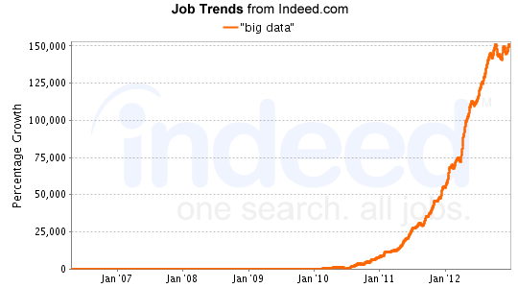
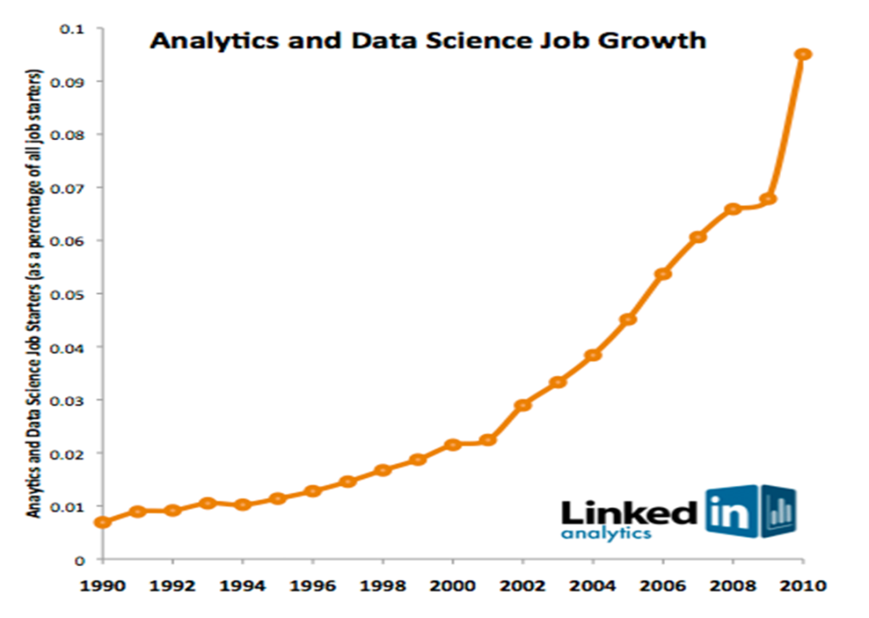
Data Science Job Growth
By 2018 shortage of 140-190,000 predictive analysts and 1.5M managers / analysts in the US
Notes:
We are part of the education ecosystem of the country
What can we do to narrow this gap effectively?

Slide 27
Data Miners: Past and Present
Traditional approaches have been for DM experts: “White-coat PhD statisticians”
DM tools also fairly expensive
Today: approach is designed for those with some Database/Analytics skills
DM built into DB, easy to use GUI, Workflows
Many jobs available from Statistical analyst to Data Scientist!
Data Science: The Art of mathematically sophisticated data engineers delivering insights from data into business decisions and systems

Slide 28
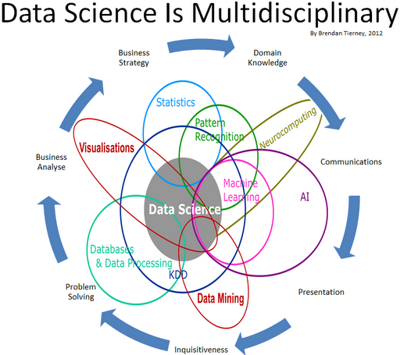

Slide 29
Successful Data Scientist Characteristics
Intellectual curiosity, Intuition
Find needle in a haystack
Ask the right questions – value to the business
Communication and engagements
Presentation skills
Let the data speak but tell a story
Story teller – drive business value not just data insights
Creativity
Guide further investigation
Business Savvy
Discovering patterns that identify risks and opportunities
Measure
Notes:
1 – find meaning in the chaos
2- Ability to ask the right questions to drive business impact;
surfacing and testing assumptions about what people think drives behavior or business
Can engage in iterative experiences with business users to ensure impact.
Not easy – can you imagine how that goes over in the first knowledge transfer meeting- Tell a story with data – from millions of data points tell us what is the guidance

Slide 30
To Ph.D or NOT Ph.D? That is the Question!
LinkedIn Poll:
Do You Need a PhD to Analyze Big Data?
YES | NO
301 (12%) | 2476 votes (87%)

Slide 31
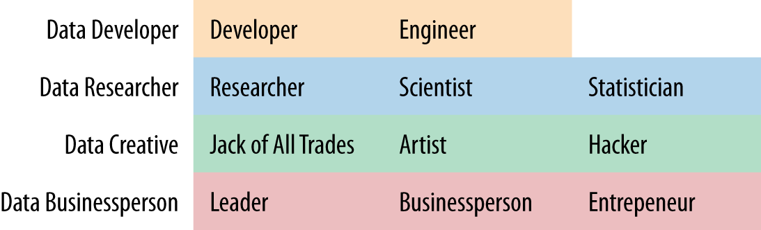
Data Scientist Self-ID
O’Reilly Strata Survey suggested Self-ID Group, along with the self-ID categories most strongly associated with each Group
Notes:
Respondents tended to agree or disagree consistently to
questions such as “I think of myself as a/an X” in each Self-ID Group.
Our suggested Self-ID Group names are shown, along with the self-ID
categories most strongly associated with each Group.

Slide 32
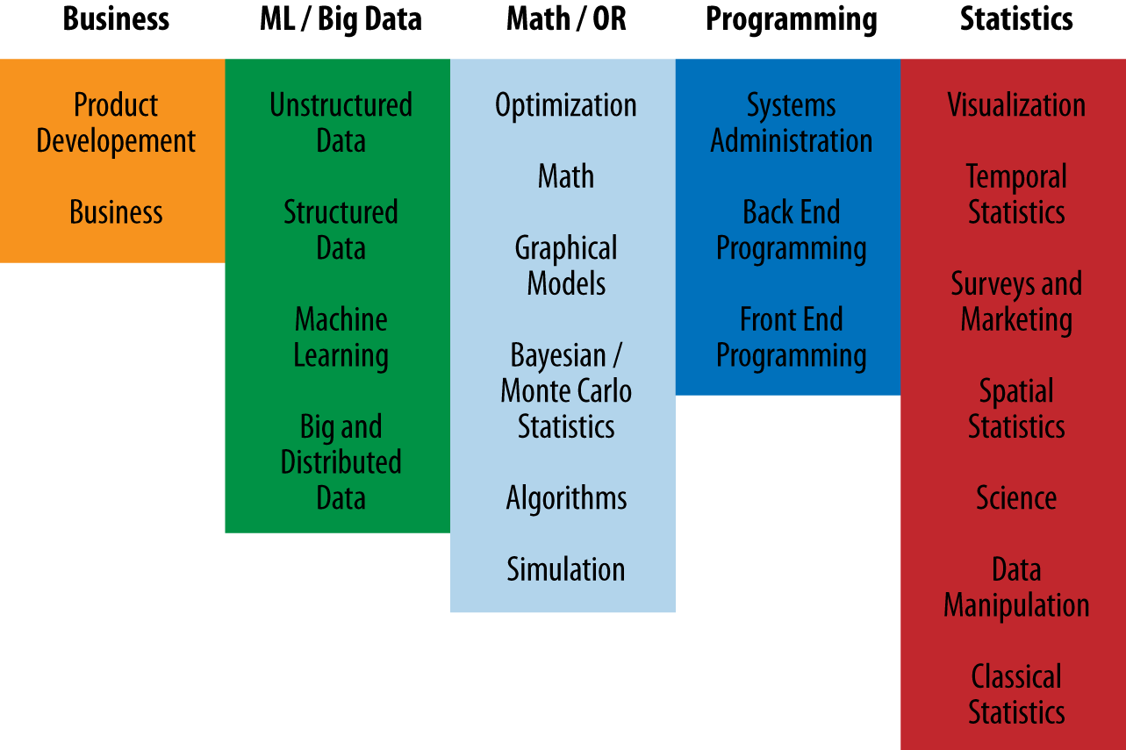
Strata Survey Skills
Strata survey, 2013
Notes:
We developed a set of 22 generic skills that we thought spanned the
range of useful things that data scientists might do in their work
(Figure 3-2). A few concrete examples were provided with each skill
to clarify and to aid ordering (see Appendix: “Skills List”). Respondents
dragged-and-dropped those skills into an ordered list, with their
introspectively determined top skill on top.
Respondents tended to rank similarly skills in each Skills
Group. Our suggested Skills Goup names are shown, along with the
skills most strongly associated with each Group. ML = “Machine
Learning” and OR = “Operations Research.”
As with the Self-ID Groups, we clustered the Skills, providing names
for each cluster to summarize those skills concisely. For example, respondents
tended to rank Spatial Statistics and Surveys and Marketing
together, either ranking both relatively high or both relatively low. As
before, most Skills categories were most strongly associated with a
single Skills Group, with two exceptions. Structured Data, which
ended up in the ML/Big Data Skills group, was also strongly associated
with the Programming skills group. And Machine Learning, which
also ended up with the ML/Big Data group, was also commonly ranked
highly by respondents who ranked Math/OR or Statistics skills highly.
It’s worth noting that because we used rankings instead of an absolute
scale, we are not suggesting that two data scientists who rank ML/Big
Data skills highly are equivalently skilled or effective. One may be a
recent university graduate, having only completed coursework in Machine
Learning, while another may have decades of experience applying
these techniques to a wide range of problems.

Slide 33
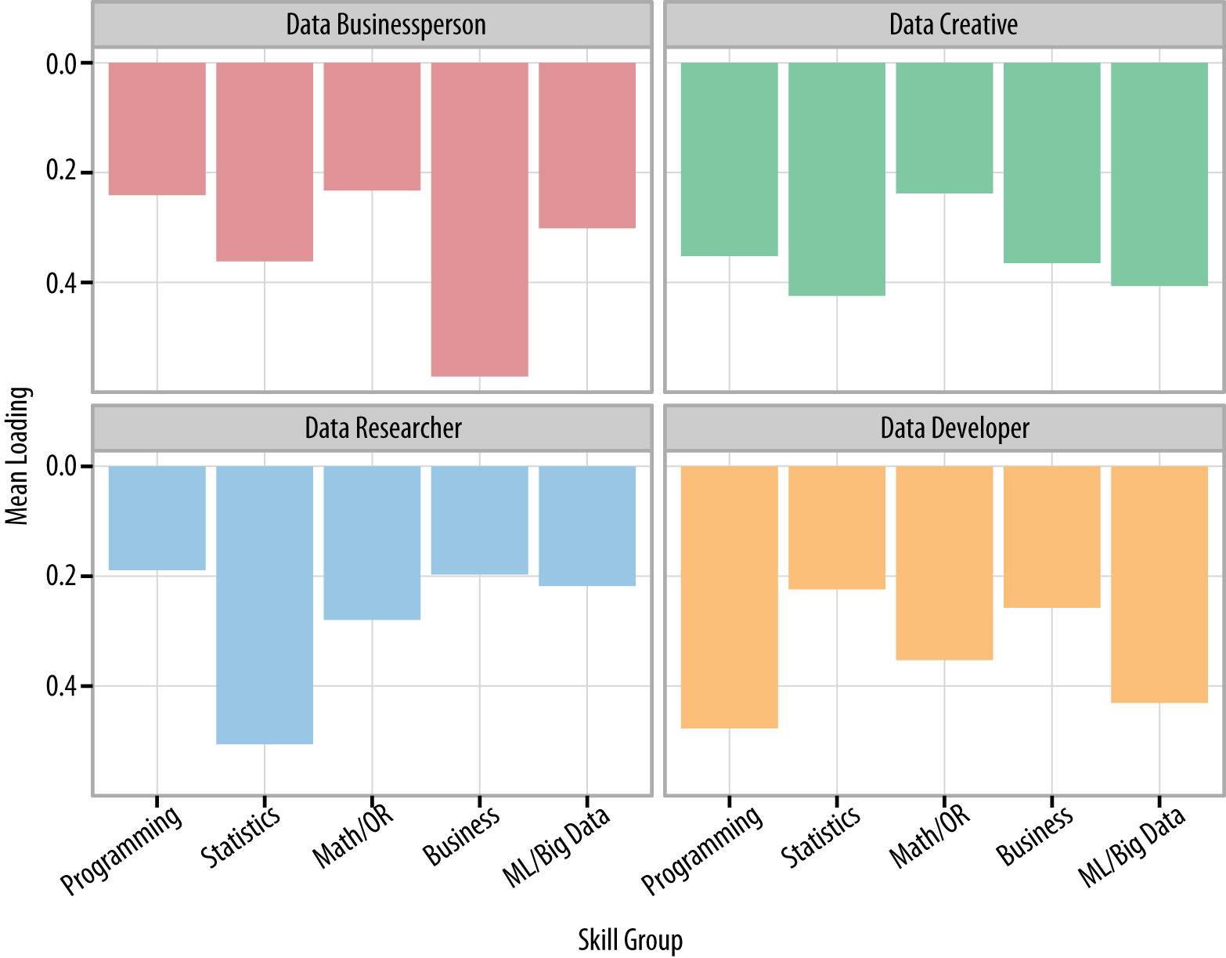
Strata survey, 2013
Notes:
Others have made this point as well. Stanton et al. (2012), in a writeup
of a recent workshop, reviewed the state of data science in a primarily
academic/"eScience” context. Interestingly, they emphasized a role
performing data archival and preservation, which is not currently a
focus of data scientists, although perhaps it should be. Their workshop
participants recommended that the breadth of T-shaped data scientists
should fall into three categories: data curation, analytics and visualization,
and networks and infrastructure. They also mention the intriguing
idea that data scientists should have (serif) “I"-shaped skills, with
domain knowledge along the bottom (see also The Data Science Venn
Diagram, Conway, 2010).
We can look at the T-shaped nature of the four Self-ID Groups as well.
Figure 4-2 shows how strongly, on average, people in each Self-ID
Group were associated with our five Skills Groups. Data Businesspeople
were quite T-shaped, with top skills in Business, and moderate
skills elsewhere. Data Researchers tended to be very deep in Statistics
(and related skills), but somewhat less broad. On average, they ranked
all of the ML/Big Data, Business, and Programming skills fairly low.
Data Developers had a pattern that might be called “Pi-shaped,” with
strong Programming skills and relatively strong ML/Big Data skills,
along with moderate skills in the other three skill groups. And finally,
Data Creatives tended to be the least T-shaped of our respondents.
Interestingly, Data Creatives were, on average, neither ranked the
strongest nor the weakest in any skill group.

Slide 34
Learning and Training Opportunities
Many MS, MAS, Courses, Training, Workshops, Certificates, Boot camps, etc.
Introduction to Data Science Example
Part 1: Data Manipulation at scale
Databases and the relational algebra
Parallel databases, parallel query processing, in-database analytics, MapReduce, Hadoop, relationship to databases, algorithms, extensions, languages
Key-value stores and NoSQL; Entity resolution, record linkage
Part 2: Analytics, Predictive Analytics, Text mining
Part 3: Communicating Results
Visualization, data products, visual data analytics
Provenance, privacy, ethics, governance
https://www.coursera.org/course/datasci
Notes:
art 0: Introduction Examples, data science articulated, history and context, technology landscape
Part 1: Data Manipulation, at Scale Databases and the relational algebra
Parallel databases, parallel query processing, in-database analytics
MapReduce, Hadoop, relationship to databases, algorithms, extensions, languages
Key-value stores and NoSQL; tradeoffs of SQL and NoSQL
Entity resolution, record linkage, data cleaning
Part 2: Analytics Basic statistical modeling, experiment design, introduction to machine learning, overfitting
Supervised learning: overview, simple nearest neighbor, decision trees/forests, regression
Unsupervised learning: k-means, multi-dimensional scaling
Graph Analytics: PageRank, community detection, recursive queries, iterative processing
Text Analytics: latent semantic analysis
Collaborative Filtering: slope-one
Part 3: Communicating Results Visualization, data products, visual data analytics
Provenance, privacy, ethics, governance

Slide 35
How long does it take for a beginner to become a good data scientist per Region?
Region (Count) | Avg Years to become a good data scientist
AU/NZ (9) | 6.9 years
E. Europe (19) | 5.9 years
US/Canada (143) | 4.9 years
W. Europe (60) | 4.9 years
Asia (25) | 4.9 years
Africa/Middle East (9) | 4.4 years
Latin America (12) | 3.9 years

Slide 36
Intro to Machine learning Data mining Predictive analytics Data Science

Slide 37
Necessity is the Mother of Invention
Data explosion
Automated data collection tools and mature database technology lead to tremendous amounts of data stored in databases, data warehouses and other information repositories
“We are drowning in data, but starving for knowledge!” (John Naisbitt, 1982)
Notes:
The PROBLEM is
The major reason that data mining has attracted a great deal of attention in recent years is due to the wide availability of huge amounts of data and the imminent need for turning such data into useful information and knowledge.
Data rich – but information poor
Lying hidden in all this data is information!

Slide 38
Necessity is the Mother of Invention
Solution
Predictive Analytics or Data Mining
Extraction or “mining” of interesting knowledge (rules, regularities, patterns, constraints) from data in large databases
Data -driven discovery and modeling of hidden patterns in large volumes of data
Extraction of implicit, previously unknown and unexpected, potentially extremely useful information from data

Slide 39
Predictive Analytics
Analytical Tools
Top-Down
Methodology
Corporate Data
Surface
SQL tools for simple queries and reporting
Shallow
Statistical & BI tools for summaries and analysis
Hidden
Data Mining methods for knowledge discovery
Bottom-Up
Methodology

Slide 40
Query Reporting | BI | Data Mining
Extraction of data; detailed and/or summarized | Analysis, summaries, Trends | Discovery of hidden patterns, information, predicting future trends
Information | Analysis | Insight knowledge and prediction
Who purchased the product in the last 2 quarters? | What is an average income of the buyers per quarter by district? | Which customers are likely to buy a similar product in the future and why?

Slide 41
DM Enables Predictive Analytics
Role of Software
Predictive Analysis
Data mining
Proactive
Interactive
BI
Ad-hoc reporting
Canned reporting
Passive
Business Insight
Presentation
Exploration
Discovery

Slide 42
What Is Data Mining?
Combination of AI and statistical analysis to discover information that is “hidden” in the data
associations (e.g. linking purchase of pizza with beer)
sequences (e.g. tying events together: marriage and purchase of furniture)
classifications (e.g. recognizing patterns such as the attributes of employees that are most likely to quit)
forecasting (e.g. predicting buying habits of customers based on past patterns)

Slide 43
Data Mining is NOT…
Data Warehousing
(Deductive) query processing
SQL/ Reporting
Software Agents
Expert Systems
Online Analytical Processing (OLAP)
Statistical Analysis Tool
Data visualization
BI – Business Intelligence

Slide 44
Multidisciplinary Field
Database
Technology
Statistics
Machine
Learning
Data Mining
Visualization
Artificial
Intelligence
Other
Disciplines

Slide 45
Data Mining is…
Multidisciplinary Field
Database technology
Artificial Intelligence
Machine Learning including Neural Networks
Statistics
Pattern recognition
Knowledge-based systems/acquisition
High-performance computing
Data visualization
Other Disciplines

Slide 46
History of Data Mining

Slide 47
History
Emerged late 1980s
Flourished –1990s
Roots traced back along three family lines
Classical Statistics
Artificial Intelligence
Machine Learning
Notes:
Data mining emerged during late 1980’s, has made great strides during 1990’s and is expected to continue to flourish into the new millennium
Recently data mining has been the subject of many articles in business and software magazines. However, just a few short years ago, few people had even heard of the term data mining. Though data mining is the evolution of a field with a long history, the term itself was only introduced relatively recently, in the 1990s. This section explores the history of data mining.
Data mining roots are traced back along three family lines. The longest of these three lines is classical statistics

Slide 48
Statistics
Foundation of most DM technologies
Regression analysis, standard distribution/deviation/variance, cluster analysis, confidence intervals
Building blocks
Significant role in today’s data mining – but alone is not powerful enough
Notes:
Foundation of most technologies on which DM is built
Without statistics, there would be no data mining, as statistics are the foundation of most technologies on which data mining is built.
Classical statistics embrace concepts such as regression analysis, standard distribution, standard deviation, standard variance, discriminant analysis, cluster analysis, and confidence intervals, all of which are used to study data and data relationships.
These are the very building blocks with which more advanced statistical analyses are underpinned. Certainly, within the heart of today's data mining tools and techniques, classical statistical analysis plays a significant role.

Slide 49
Artificial Intelligence
Heuristics vs. Statistics
Human-thought-like processing
Requires vast computer processing power
Supercomputers
Notes:
Data mining's second longest family line is artificial intelligence, or AI. This discipline, which is built upon heuristics as opposed to statistics, attempts to apply human-thought-like processing to statistical problems.
Because this approach requires vast computer processing power, it was not practical until the early 1980s, when computers began to offer useful power at reasonable prices.
AI found a few applications at the very high end scientific/government markets, but the required supercomputers of the era priced AI out of the reach of virtually everyone else.
The notable exceptions were certain AI concepts which were adopted by some high-end commercial products, such as query optimization modules for Relational Database Management Systems (RDBMS).

Slide 50
Machine Learning
Union of statistics and AI
Blends AI heuristics with advanced statistical analysis
Machine Learning – let computer programs
learn about data they study - make different decisions based on the quality of studied data
using statistics for fundamental concepts and adding more advanced AI heuristics and algorithms
Notes:
The third family line of data mining is machine learning, which is more accurately described as the union of statistics and AI.
While AI was not a commercial success, its techniques were largely co-opted by machine learning.
Machine learning, able to take advantage of the ever-improving price/performance ratios offered by computers of the 80s and 90s, found more applications because the entry price was lower than AI.
Machine learning could be considered an evolution of AI, because it blends AI heuristics with advanced statistical analysis.
Machine learning attempts to let computer programs learn about the data they study, such that programs make different decisions based on the qualities of the studied data, using statistics for fundamental concepts, and adding more advanced AI heuristics and algorithms to achieve its goals.

Slide 51
Terminology
Gold Mining
Knowledge mining from databases
Knowledge extraction
Data/pattern analysis
Knowledge Discovery Databases or KDD
Information harvesting
Business intelligence
Predictive Analytics
Data Science
Notes:
Just as mining of gold from rocks and sand is referred to as gold mining rather than rock or sand mining
Thus data mining should have been more appropriately named knowledge mining from data or short knowledge mining
Some terms used are: knowledge mining from databases, knowledge extraction, data/pattern analysis, data archeology and so on..
Another popular term is Knowledge discovery Databases or KDD

Slide 52
TAXONOMY
Predictive Methods
Use some variables to predict some unknown or future values of other variables
Descriptive Methods
Find human –interpretable patterns that describe the data
Supervised vs. Unsupervised
Notes:
Predictive mining task performs inference on the current data in order to make predictions
Descriptive – characterizes the general properties of the data

Slide 53

What does Data Mining Do?
Explores Your Data
Finds Patterns
Performs Predictions

Slide 54
What can we do with Data Mining?
Exploratory Data Analysis
Predictive Modeling: Classification and Regression
Descriptive Modeling
Cluster analysis/segmentation
Discovering Patterns and Rules
Association/Dependency rules
Sequential patterns
Temporal sequences
Deviation detection
Notes:
1. Classification
The system learns how to partition the data. The system is supplied with examples of objects from different groups, and it then decides on a profile of each group based on fields or attributes that are unique to the group. It can then decide which
group new data belongs to as it is fed into the system.
2. Association / Dependency
The system explores the data, trying to find out if there is any relationship between different attributes, that is, it finds out if the presence of one set of items implies the presence of another set of items. For example, 50% of people who buy milk also buy cheese.
3. Sequential patterns
The system searches through the data and tries to identify repeated patterns within it, such that the presence of one set of items is followed by another set of items.
For example, 10% of people with diabetes develop a treatable loss in eyesight.
4. Temporal (time) sequences
Given a set of time sequences the system can identify correspondence, or regular recurrences of the same sequence. Deviation detection
The system can determine if there has been a considerable change in an attribute from the previous or expected value.

Slide 55
Data Mining Applications
Science: Chemistry, Physics, Medicine, Energy
Biochemical analysis, remote sensors on a satellite, medical image analysis
Bioscience
Sequence-based analysis, protein structure and function prediction, protein family classification, microarray gene expression
Pharmaceutical, Insurance, Health care, Medicine
Drug development, medical therapies, claims analysis, fraudulent behavior, medical diagnostics
Financial Industry, Banks, Businesses, E-commerce
Stock and investment analysis, identify loyal customers vs. risky customer, predict customer spending, risk management, sales forecasting
Market analysis and management
Target marketing, CRM, market basket analysis, cross selling, market segmentation
Risk analysis and management
Forecasting, customer retention, improved underwriting, quality control, competitive analysis
Sports and Entertainment
IBM Advanced Scout analyzed NBA game statistics (shots blocked, assists, and fouls) to gain competitive advantage for New York Knicks and Miami Heat
Notes:
Astronomy
JPL and the Palomar Observatory discovered 22 quasars with the help of data mining
Campaign Management and Database Marketing

Slide 56
Data Mining Tasks
Concept/Class description: Characterization and discrimination
Generalize, summarize, and contrast data characteristics, e.g., dry vs. wet regions; “normal” vs. fraudulent behavior
Association (correlation and causality)
Multi-dimensional interactions and associations
age(X, “20-29”) ^ income(X, “60-90K”) à buys(X, “TV”)
Hospital(area code) ^ procedure(X) ->claim (type) ^ claim(cost)
Notes:
Characterization: is a summarization of the general characteristics or features of a target class of data.
Data discrimination is a comparison of the general features of target class data objects with the general features of objects from one or a set of contrasting classes
Association analysis is the discovery of a association rules showing attribute – value conditions that occur frequently together in a given set of data
If we utilize techniques that classify or predict, we have constructed a data mining problem where we already know the outcome – we already know what “Normal” should look like, or we already have cases fraud. But remember fraudsters are tricky – if you catch them they will try to find other way to take advantage of the system.
Many times when we are working with fraud, we do not know what it looks like. Grouping and association algorithms to help us handle these situations when we don’t know what fraud looks like. Using these techniques we might be able to learn what a “normal” case looks like. Cases that appear abnormal can be pulled out and reviewed more carefully.

Slide 57
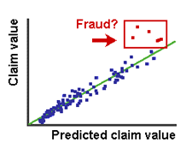
Data Mining Tasks
Classification and Prediction
Finding models (functions) that describe and distinguish classes or concepts for future prediction
Example: classify countries based on climate, or classify cars based on gas mileage, fraud based on claims information, energy usage based on sensor data
Presentation:
If-THEN rules, decision-tree, classification rule, neural network
Prediction: Predict some unknown or missing numerical values
Notes:
Is a process of finding a set of models (or functions) that describe and distinguish data classes or concepts for the purpose of being able to use the model to predict the class of objects whose class label is unknown
The derived model is base on the analysis of a set of training data (data objects whose class label are known)
When predicted values are numerical data it is specifically referred to as prediction
If we choose to use a technique to predict, we may have a set of audited billing cases, for example. We might be able to build a model to predict what the cost for a particular procedure or product should be. We then may apply this model to new cases to predict what the actual expenditure was versus the expected expenditure. If costs exceed what was expected, these cases might be examine more closely.

Slide 58
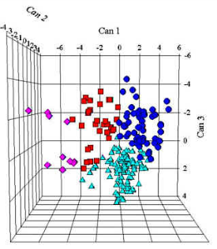
Data Mining Tasks
Cluster analysis
Class label is unknown: Group data to form new classes
Clustering based on the principle: maximizing the intra-class similarity and minimizing the interclass similarity
Outlier analysis
Data object that does not comply with the general behavior of the data
Mostly considered as noise or exception, but is quite useful in fraud detection, rare events analysis
Trend and evolution analysis
Trend and deviation: regression analysis
Sequential pattern mining, periodicity analysis
Notes:
Unlike classification and prediction which analyze class labeled data objects clustering analyzes data objects without consulting a known class label
In general the class labels are not present in the training data simply because they are not known to begin with
Clustering can be used to generate such labels
Grouping (otherwise known as clustering) algorithms may be employed in circumstances where we do not know what “fraud” looks like.
we generally build the clusters, then build profiles of the cluster to understand the characteristics of the cluster membership. In this way, our experience has show the “Cluster Profile” may have telling characteristics that would indicate a need for further investigation.
Our goal is simply to get a good picture of what all the cases look like. We would like to believe that somehow and individual that might be committing fraud would likely have some characteristics, or patterns of behavior, the somehow look different from other cases. Using clustering routines, we can find that outlier cases.
Of course, in some of the situations that have been cited in the earlier discussion today, waste fraud and abuse are so prevalent that membership to this cluster would be very high. In those cases, we generally build the clusters, then build profiles of the cluster to understand the characteristics of the cluster membership. In this way, our experience has show the “Cluster Profile” may have telling characteristics that would indicate a need for further investigation.

Slide 59

KDD Process
Database
Selection Transformation
Data Preparation
Training Data
Data Mining
Model, Patterns
Evaluation, Verification
Notes:
Knowledge data discovery

Slide 60
KDD Process Steps
Learning the application domain:
relevant prior knowledge and goals of application
Creating a target data set: data selection
Data cleaning and preprocessing: (may take 60% of effort!)
Data reduction and transformation:
Find useful features, dimensionality/variable reduction, representation
Choosing functions of data mining
summarization, classification, regression, association, clustering

Slide 61
KDD Process Steps (2)
Choosing functions of data mining
summarization, classification, regression, association, clustering
Choosing the mining algorithm(s)
Data mining: search for patterns of interest
Pattern evaluation and knowledge presentation
visualization, transformation, removing redundant patterns, etc.
Use and integration of discovered knowledge

Slide 62
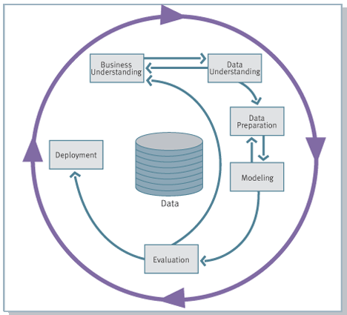
CRISP-DM - Cross Industry Standard Process for Data Mining
CRISP-DM Process Model
Notes:
Data Preparation:
Data Selection
Cleaning
Filtering
Attribute Selection
Attribute Manipulations
Model Building:
classification, clustering, connectionist models
Model Analysis and Interpretation
Pattern Discovery and Data Prediction

Slide 63
Learning and Modeling Methods
Decision Tree Induction (C4.5, J48)
Regression Tree Induction (CART, MP5)
Multivariate Regression Tree (MARS)
Clustering (K-means, EM, Cobweb)
Artificial Neural Networks (Backpropagation, Recurrent)
Support Vector Machines (SVM)
Various other models
Notes:
Genetic algorithms, Hidden Markov models
Bayesian networks and probabilistic inference
Support vector machines
Inductive learning

Slide 64
Decision Tree Induction
Method for approximating discrete-valued functions
robust to noisy/missing data
can learn non-linear relationships
inductive bias towards shorter trees
Notes:
One of the most popular and practical methods for inductive inference and concept learning
Learned trees can also be re-represented as sets of if-then rules to improve human readability.
Searches a complete hypothesis space
The is an inductive bias implicit in the algorithm - it includes a preference for smaller trees.
That is it’s search through the hypothesis space grows the tree only as large as needed in order to classify the available training examples.

Slide 65
Decision Tree Induction
Applications:
medical diagnosis – ex. heart disease
analysis of complex chemical compounds
classifying equipment malfunction
risk of loan applicants
Boston housing project – price prediction
fraud detection
Notes:
DT algorithm has been successfully applied to a wide range of learning tasks from medical diagnosis to classifying equipment malfunction by their cause
Simple to understand
Works with data types

Slide 66
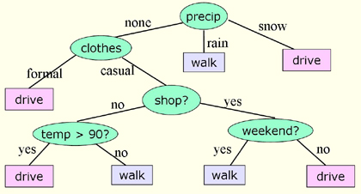
Decision Tree Example

Slide 67
Regression Tree Induction
Why Regression tree?
Ability to:
Predict continuous variable
Model conditional effects
Model uncertainty
Notes:
Regression trees are a special type of decision trees that deal with a continuous goal variable as well as continuous attributes.
Their inner nodes are labeled with a test on the value of the attribute, and their leaves are labeled with a function that prescribes a value to the class.

Slide 68
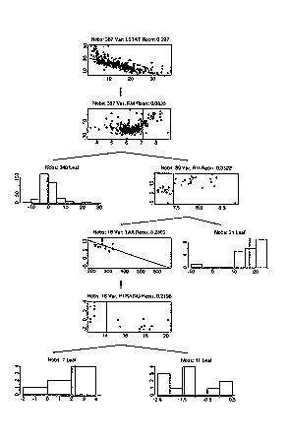
Regression Trees
Continuous goal variables
Induction by means of an efficient recursive partitioning algorithm
Uses linear regression to select internal nodes
Quinlan, 1992
Notes:
Put the picture of the split node!!!!
These methods perform induction by means of an efficient recursive partitioning algorithm.
Just like in decision tree one of the main decisions that needs to be made during the tree growth is to find the best split for each node. This task is made more complicated by the presence of the continuous variables.
It fits a linear model to the data for each possible continuous feature
And then picks the model that has the smallest mean relative error.

Slide 69
Clustering
Basic idea: Group similar things together
Unsupervised Learning – Useful when no other info is available
K-means
Partitioning instances into k disjoint clusters
Measure of similarity
Notes:
The classic k-means algorithm which is a simple straightforward technique that forms clusters in numeric domains, by partitioning instances into k (pre determined) disjoint clusters based on some measure of similarity in our case Euclidian distance

Slide 70
Clustering
X
X
X
X
Notes:
This method initially takes the specification of the final required number of clusters–which is represented by the parameter k. The algorithm starts with k randomly generated seed cluster centers. Instances are then assigned to their closest cluster center according to the distance function.
This function can be ordinary Euclidian distance, angle between vectors or a correlation coefficient.
The next step in the algorithm is to calculate the mean of all instances in each cluster, which will become the new centroid for the respective clusters. The whole process is then iteratively repeated with the new cluster centers, until no changes occur and the same points are assigned to each cluster in consecutive rounds.

Slide 71
Kmeans Results from 10 million NYTimes articles
cluster means shown
with coordinates
determining fontsize
7 viable clusters found
Notes:
10,000,000 entries from NYTimes articles (http://archive.ics.uci.edu/ml/datasets/Bag+of+Words)

Slide 72
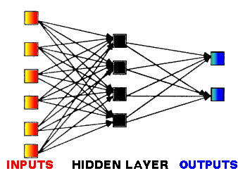
Artificial Neural Networks (ANNs)
Network of many simple units
Main Components
Inputs
Hidden layers
Outputs
Adjusting weights of connections
Backpropagation
Notes:
An ANN is a network of many simple units, which could possibly have a small amount of local memory, connected by communication channels capable of carrying numeric data of various kinds.
These units operate only locally on the data they receive through their inputs.
The processing ability of the network is stored in the inter-unit connection strength or weights that are being adapted based on a set of training data.
Most ANNs have a training rule whose role is to adjust weights of connections based on the input data.
They are capable of learning from experience and generalizing beyond the training data

Slide 73
Evaluation
Error on the training data vs. performance on future/unseen data
Simple solution
Split data into training and test set
Re-substitution error
error rate obtained from the training data
Three sets
training data, validation data, and test data
Notes:
We have the training set; surely we can just look at how
well different methods do on that. Well, no: as we will see very shortly, performance
on the training set is definitely not a good indicator of performance
on an independent test set.We need ways of predicting performance bounds in
practice, based on experiments with whatever data can be obtained.
When a vast supply of data is available, this is no problem: just make a model
based on a large training set, and try it out on another large test set. But although
data mining sometimes involves “big data”—particularly in marketing, sales,
and customer support applications—it is often the case that data, quality data,
is scarce.
Even in the credit card application (pages 22–23), there
turned out to be only 1000 training examples of the appropriate type. The electricity
supply data (pages 24–25) went back 15 years, 5000 days—but only 15
Christmas Days and Thanksgivings, and just 4 February 29s and presidential
elections. The electromechanical diagnosis application (pages 25–26) was able
to capitalize on 20 years of recorded experience, but this yielded only 300 usable
examples of faults. Marketing and sales applications (pages 26–28) certainly
involve big data, but many others do not: training data frequently relies on specialist
human expertise—and that is always in short supply.

Slide 74
Training and Testing
Test set
set of independent instances that have not been used in formation of classifier in any way
Assumption
data contains representative samples of the underlying problem
Example: classifiers built using customer data from two different towns A and B
To estimate performance of classifier from town in completely new town, test it on data from B
Notes:
To predict the performance of a classifier on new data, we need to assess its
error rate on a dataset that played no part in the formation of the classifier. This
independent dataset is called the test set. We assume that both the training data
and the t
Suppose the
bank had training data from branches in New York City and Florida and wanted
to know how well a classifier trained on one of these datasets would perform in
a new branch in Nebraska. It should probably use the Florida data as test data
to evaluate the New York-trained classifier and the New York data to evaluate
the Florida-trained classifier. If the datasets were amalgamated before training,
performance on the test data would probably not be a good indicator of performance
on future data in a completely different state.est data are representative samples of the underlying problem.

Slide 75
Error Estimation Methods
Holdout
½ training and ½ testing (2/3&1/3)
Repeated Holdout Method
Random sampling – repeated holdout
Cross-validation
Partition in K disjoint clusters
Train k-1, test on remaining
Leave-one-out Method
Bootstrap
Sampling with replacement
Notes:
To predict the performance of a classifier on new data, we need to assess its
error rate on a dataset that played no part in the formation of the classifier. This
independent dataset is called the test set. We assume that both the training data
and the t
Suppose the
bank had training data from branches in New York City and Florida and wanted
to know how well a classifier trained on one of these datasets would perform in
a new branch in Nebraska. It should probably use the Florida data as test data
to evaluate the New York-trained classifier and the New York data to evaluate
the Florida-trained classifier. If the datasets were amalgamated before training,
performance on the test data would probably not be a good indicator of performance
on future data in a completely different state.est data are representative samples of the underlying problem.

Slide 76
Data Mining Challenges
Computationally expensive to investigate all possibilities
Dealing with noise/missing information and errors in data
Mining methodology and user interaction
Mining different kinds of knowledge in databases
Incorporation of background knowledge
Handling noise and incomplete data
Pattern evaluation: the interestingness problem
Expression and visualization of data mining results

Slide 77
Data Mining Heuristics and Guide
Choosing appropriate attributes/input representation
Finding the minimal attribute space
Finding adequate evaluation function(s)
Extracting meaningful information
Not overfitting

Slide 78
Available Data Mining Tools
COTs:
IBM Intelligent Miner
SAS Enterprise Miner
Oracle ODM
Microstrategy
Microsoft DBMiner
Pentaho
Matlab
Teradata
Open Source:
Python
R
WEKA
KNIME
Orange
RapidMiner
Rattle
Mahout
MlLib

Slide 79



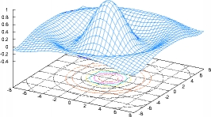


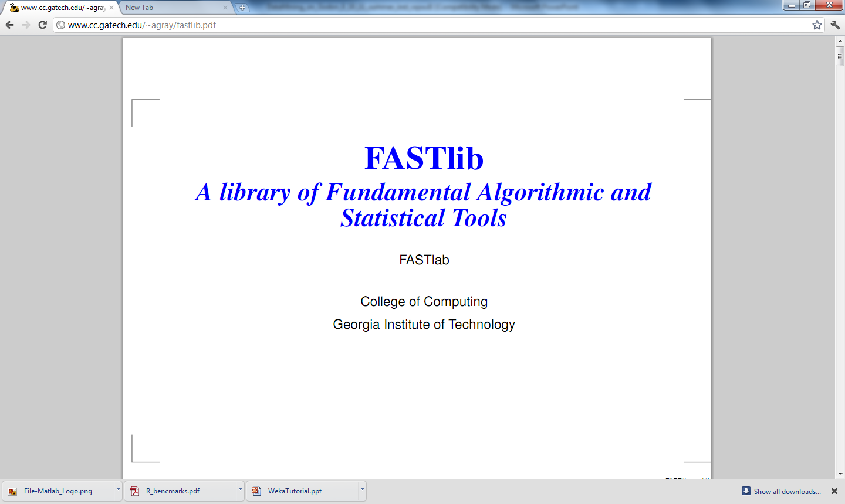
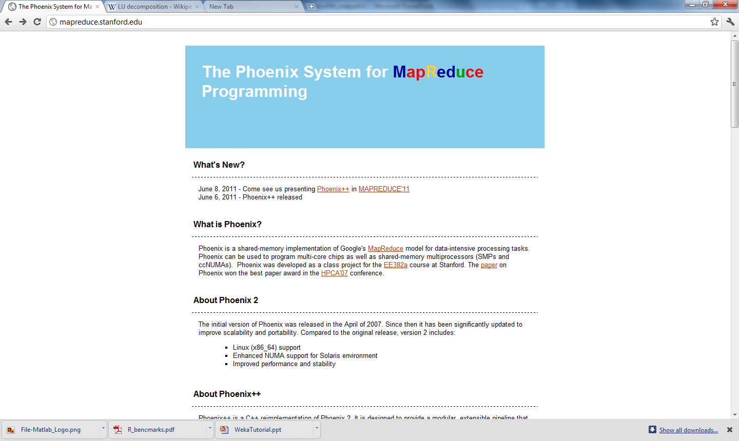
Data mining applications at SDSC
DM Suites
MathWorks
Octave
Computational Packages with DM tools
Others as
Requested
Libraries for building tools

Slide 80
Summary
Discovering interesting patterns from large amounts of data
CRISP-DM Industry standard
Learn from the past
High quality, evidence based decisions
Predict for the future
Prevent future instances of fraud, waste & abuse
React to changing circumstances
Current models, continuous learning
Notes:
To summarize – data mining is the key to detecting and preventing fraud, waste and abuse in your organization. Data mining can help you:
Analyze – learn from the past
Predict – pre-empt future fraud waste and abuse
React to changing circumstances – continuously learn from the newest cases

Slide 81
Thank you!

Slide 82
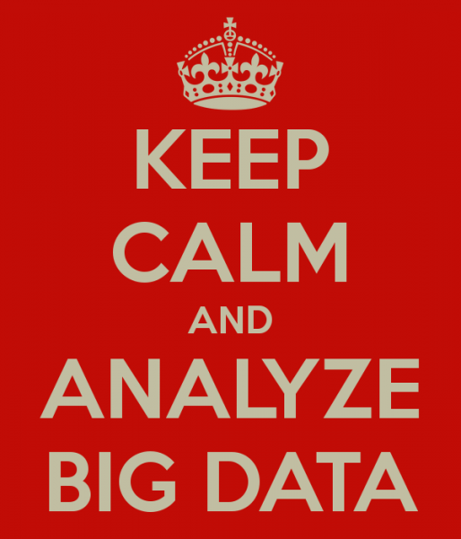
Mike Gualtieri's blog

Slide 83

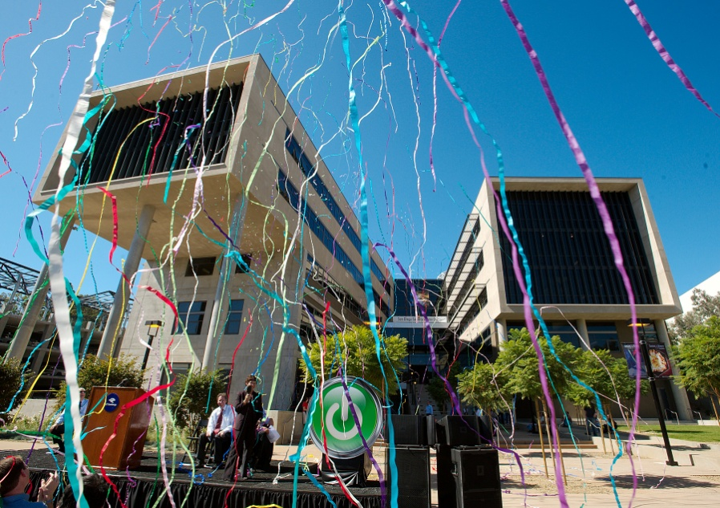
Questions?
www.sdsc.edu
For further information, contact Natasha Balac (nbalac@ucsd.edu)

